Slide 1
OneTogether
Stop the Flow!
Reducing Movement in Theatre

Slide 2
Supportive body of evidence: Stop the Flow
Patient safety in the operating theatre: how A3 thinking can help reduce door movement.
Frederique Elisabeth Simons et al. (2014) International Journal for Quality in Health Care.Vol 26, Number 4:pp, 366-371

Slide 3
Stop the Flow
Dutch SSI risk reduction guidance :
Antibiotic prophylaxis
Avoid hair removal
Perioperative normothermia
Hygiene discipline
Hygiene Discipline includes a focus on limiting door movement during surgery

Slide 4
Stop the Flow: the negative impact on theatre environment
Door movement correlated:
Elevated airborne bacteria-carrying particles
Disturbance in air flow
Difficulty in maintaining temperature
Lynch et al (2009) Measurement of foot traffic in the operating room: implications for infection control. Am J Med Quality; 24: 45-52

Slide 5
Lean A3 intervention
2 phased study at a 733 bed university hospital Amsterdam, 16 ORs
Phase 1: monitored door movement over 8 months (digital counter)
9089 procedures from incision to closure
After exclusions data related to 8009 procedures
Phase 2: Lean A3 intervention over 12 months in orthopaedic surgery (OR3)
Structured problem solving based on plan do check act cycle

Slide 6
Why LEAN A3?
Captures the problem
Analysis
Improvement actions
Action plan
On A3 size visual
Applicable to staff groups with little time for problem solving
Analysis provides an opportunity to reflect on practice, the why of movement.
Multi disciplinary team and Lean Coach took part

Slide 7
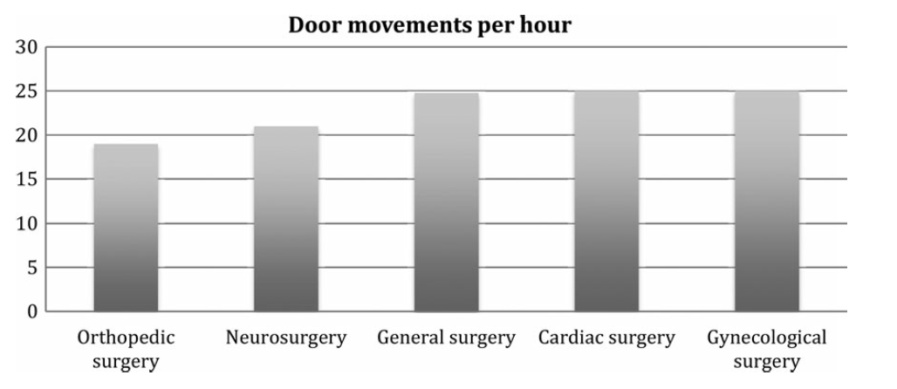
Results: Phase 1
272 805 door movements in 8009 procedures
71% scrub room door
24% setting up room door
5% patient entrance door
Range per procedure 0-555
Mean of 32 across 26 specialisms
Mean per hour 24
The duration of the surgery=door movement increase P<0.01

Slide 8
Phase 2: Lean A3 introduced
Multidisciplinary team reviewed results for OR3, Orthopaedic surgery
Scrub door opened 15-20 times per hour during a procedure
Other doors negligible
Also a difference between surgeons
Fish-bone exercise resulted in 13 root causes
3 identified for attention (firstly)
Set a target of zero
Determined limited occasions for door movement

Slide 9
Analysis and interventions
Causes
Little awareness of policy concerning door movement
Communications from inside OR to external required door opening
No visual reminders about restricted movement during procedure
Surgeon determined who can move in and out during surgery: communication strategy
Telephone communication facilitated
Warning sign of procedure in progress organised

Slide 10
Visual aids to measure
Door movements were monitored and reported within the OR on a digital screen
Print out of each weeks trends were recorded and sent by email to the team
And displayed outside of that OR

Slide 11
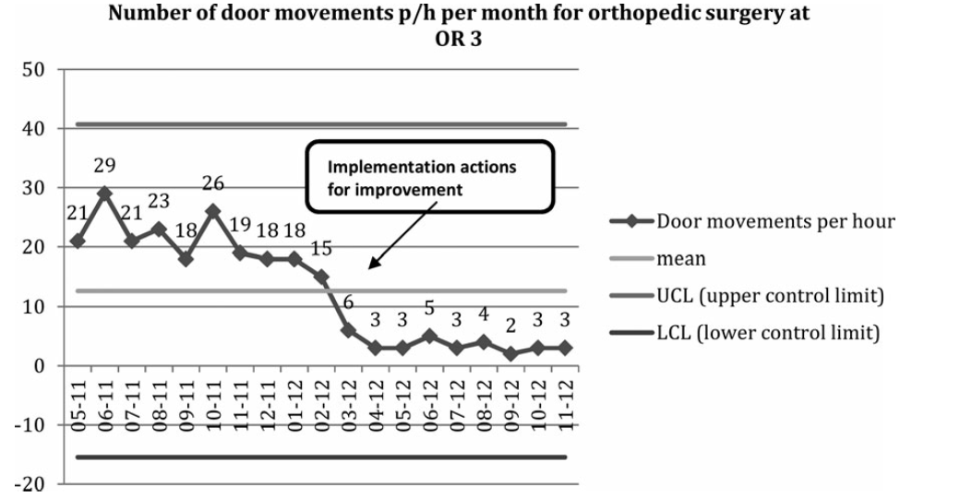
6 month stage

Slide 12
Stop the Flow: Evaluation of airborne microbial contamination, for comparison with recommended values
HTM 03-01: For example: working ultraclean theatre ≤ 10 cfu/m³ within 300mm of the wound
Air samplings in various theatres, active and passive methods
Also:
Number of persons present
Movement in and out of theatre
Agodi et al. (2015) Operating theatre ventilation systems and microbial air contamination in total joint replacement surgery: results of the GISIO-ISChIA study: Journal of Hospital Infection: 90, 213-219

Slide 14
Results
Positive correlation between values
and number of people present (Spearman's correlation coefficient 0.377; P<0.001 )
and number of door openings (Spearman's correlation coefficient 0.345; P<0.001 )

Slide 15
Recommendations
Increase all staff awareness of the risks
Those responsible for infection control should promote periodic audit
Ensure correct policy(standard)is agreed and implemented

Slide 16
THANK YOU

